Slide 1
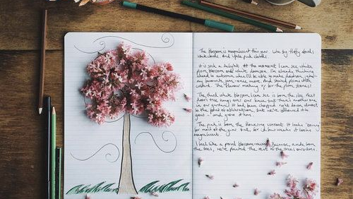
Creativity
A key to improving wellbeing

Slide 2
Creativity and wellbeing
Research has found that even small amounts of creativity can boost wellbeing
Small things can enhance your wellbeing
Five ways to wellbeing
Notes:
There has been a lot of research that has found that even small amounts of creativity can boost your wellbeing

Slide 3
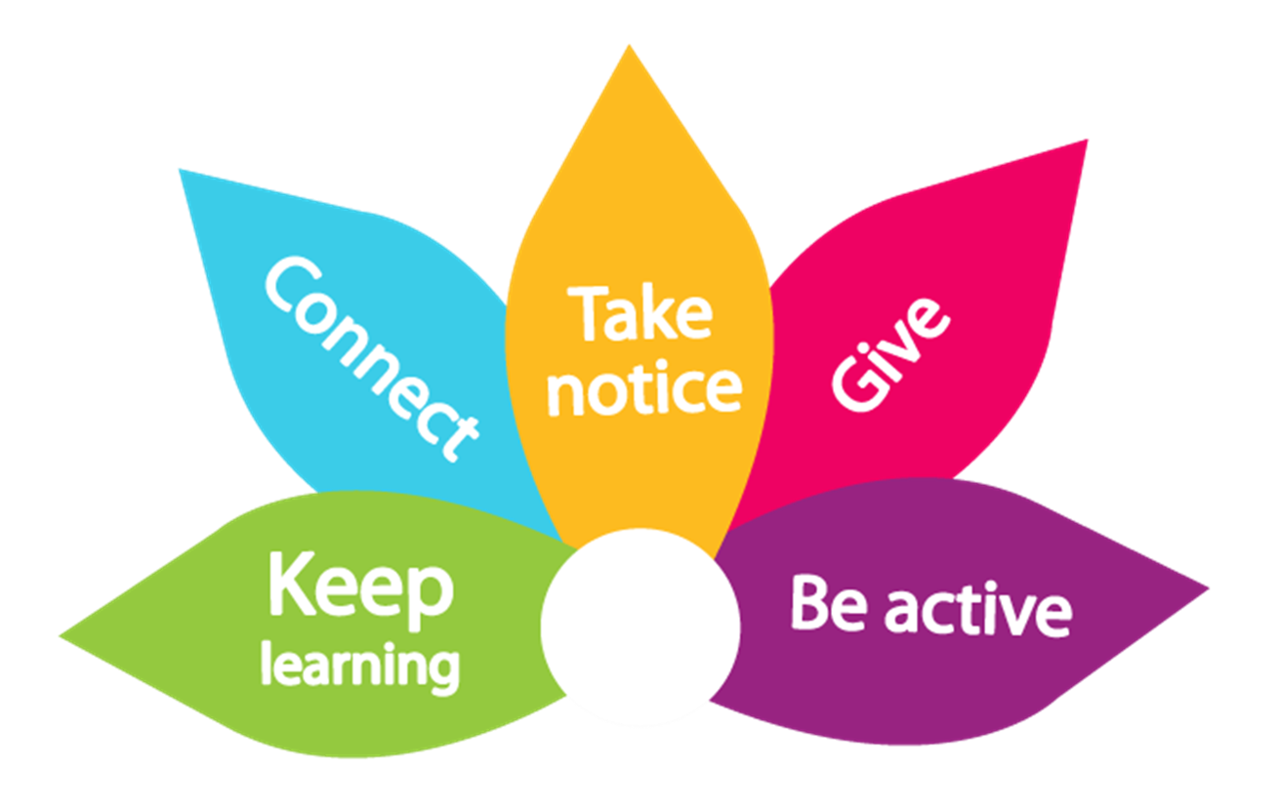
Five ways to Wellbeing
Notes:
Being creative can fall into each of the wellbeing categories depending on what you do.
For example
Keep learning – you may choose to do something new and have to learn how to do it
Connect – You may choose to join a group virtually or do this task with your friends or loved one
Take notice – Whilst your doing the activity your in the present and you are paying attention to what you are doing not thinking about the past or future
Give – You may chose to give what you create as gifts of give your time to help teach a friend about the new skill you have learnt
Be active – if you choose to be creative by doing, dance, drama, yoga or even going for a walk and then sitting and doing your activity there

Slide 4
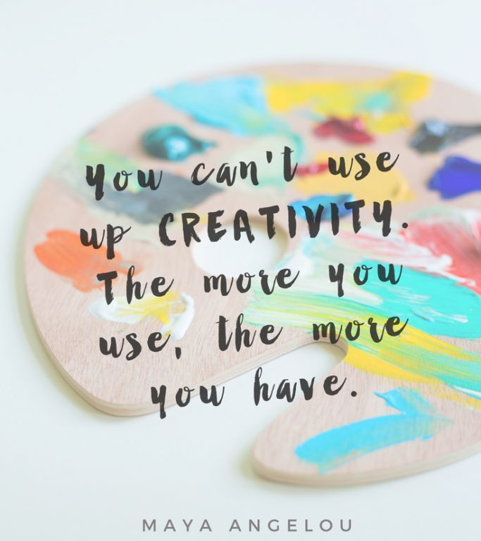
Notes:
Lovely quote from Maya Angelou

Slide 5
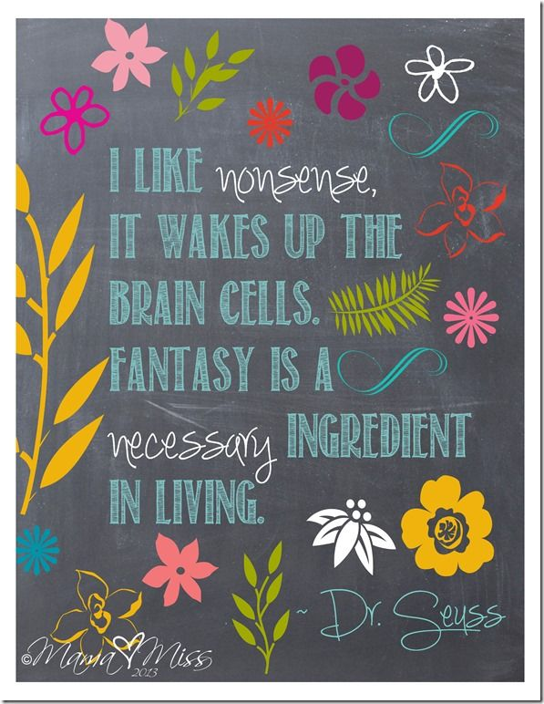
Creative ideas
Being creative can help us focus on the present moment, strengthen our sense of identity and generally help us feel more positive.
We can often forget how to be creative and have fun as adults.
With the daily pressure of caring roles it can be the last thing on our mind, having to chase medications with GP/Pharmacy or getting our loved ones up and motivated.

Slide 6
Types of creativity
Creative Journaling
Art
Crafting – making models, knitting
Home improvements and DIY
Gardening
Upcycle
Music
Photography- smartphone photography
Dance – yoga
Drama
Writing a blog
Creative writing
Instagram
Notes:
There are a lots of different types people can be creative. This is a list but there are many other things – can you think of anything you want to add or have you done any of these things in the past?
This list is endless – being creative is personal to you.

Slide 7
Creative Journaling
Improve memory and cognition – (Baikie, 2018)
Increase happiness and improve emotional regulation (especially in men) – (Lieberman, 2009)
Boost immune system and promote faster healing (Broadbent, 2015)
Writing daily gratitude's for 1 month was shown to increase happiness levels even 4 months later (Wong, 2016)
Notes:
At Hope College we focus on Creative Journaling as a good place to start to improve mental health and wellbeing. Research has shown it can really improve mental wellbeing. Its also one of the simplest places to start as you just need a pen and book/paper/journal
Research says that expressive writing has been shown to: read list
There are different types of creative journaling including bullet journaling with can be a really good place to start to track and form habits in a kind way.

Slide 8
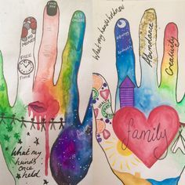
How to start
Use journaling prompts
Create a habit tracker
Set aside small amount of time at the same time of day
Get inspired – get others involved
Plan ahead
Resources – YouTube, Pinterest, library, the works, Poundland
Notes:
We have come up with a list of things that can help you start. But it should be noted that this should be something that brings you joy and should not cause any additional stress.

Slide 9
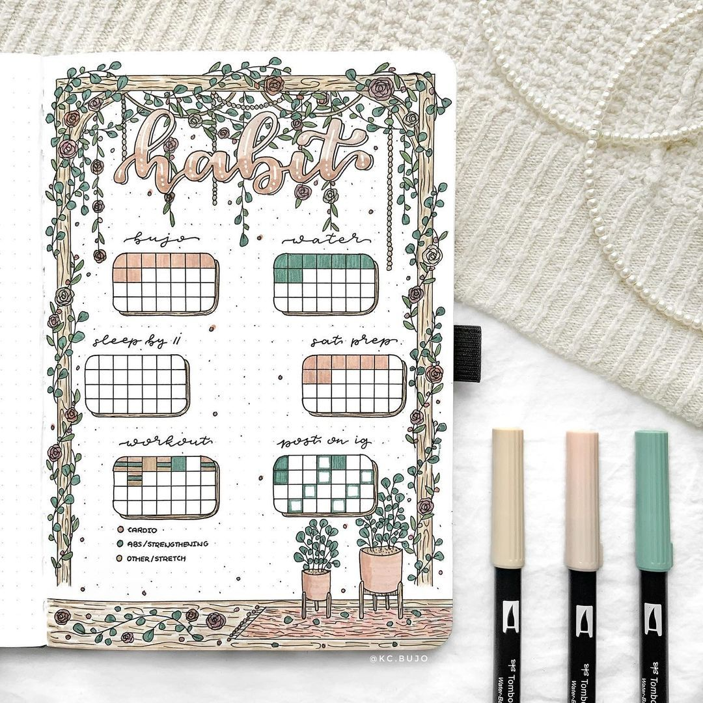
Avoid getting stuck
Be kind to yourself
Make it fun – it should not feel like a chore
Make it easy – don’t overthink

Slide 10
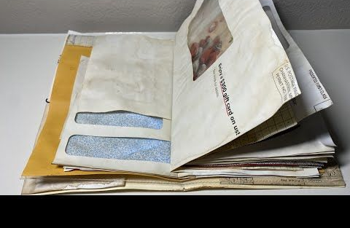
Junk Journal out of Junk mail
Notes:
Show Clip

Slide 11
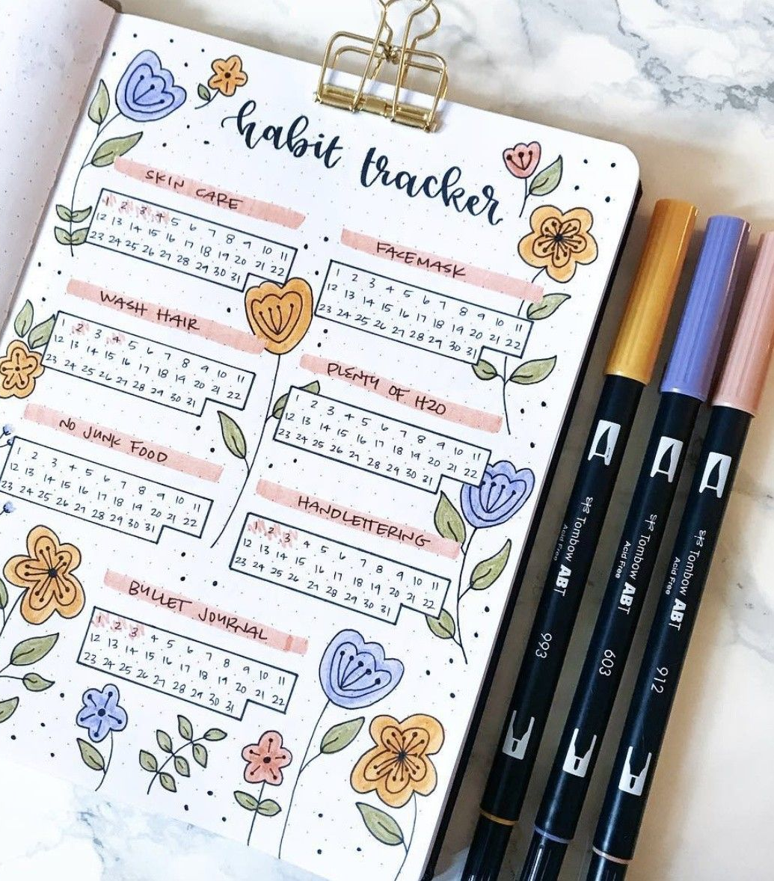
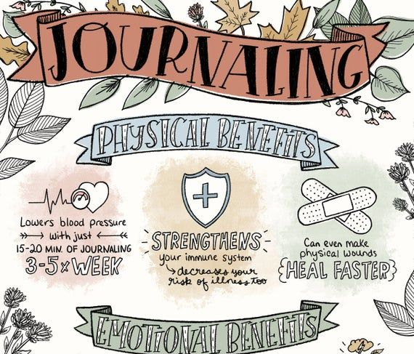
Creativity Prompts

Slide 12
Time to share – Lets create

